Slide 1
CS673 Team2 Iteration1
1.Introduce our architecture
2.File structure and episode of code
3.Demo of our app

Slide 2
Framework
Front-end: Javascript, HTML, CSS
Back-end: Java, Spring, SpringMVC
Server: Apache tomcat
Database: MySQL

Slide 3
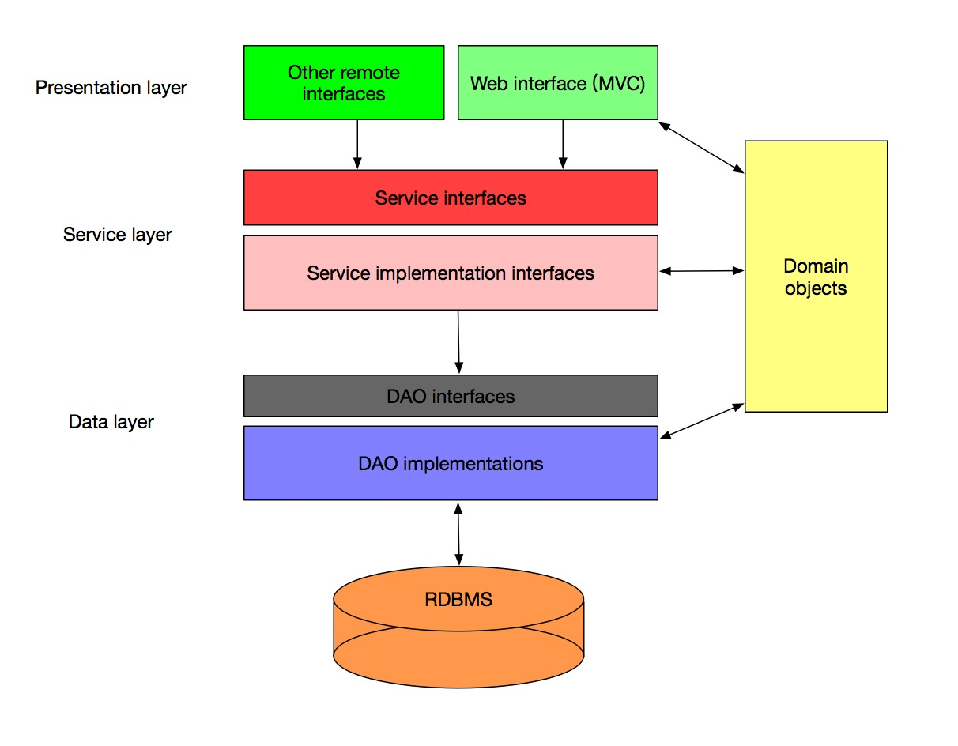
Our architecture
Our architecture basically have 3 layers:
Presentation layer, service layer and data layer.
Every of them will only interact with next level so that everyone can focus on how to implement their own interface while developing. For example, at DAO interface layer, you only need to think how to retrieve data from database and wrap them as an object of our model.
Besides, every layer will interact with others with interface so that when things change, you only need to write a new implementation of this interface without rewrite other part.

Slide 4
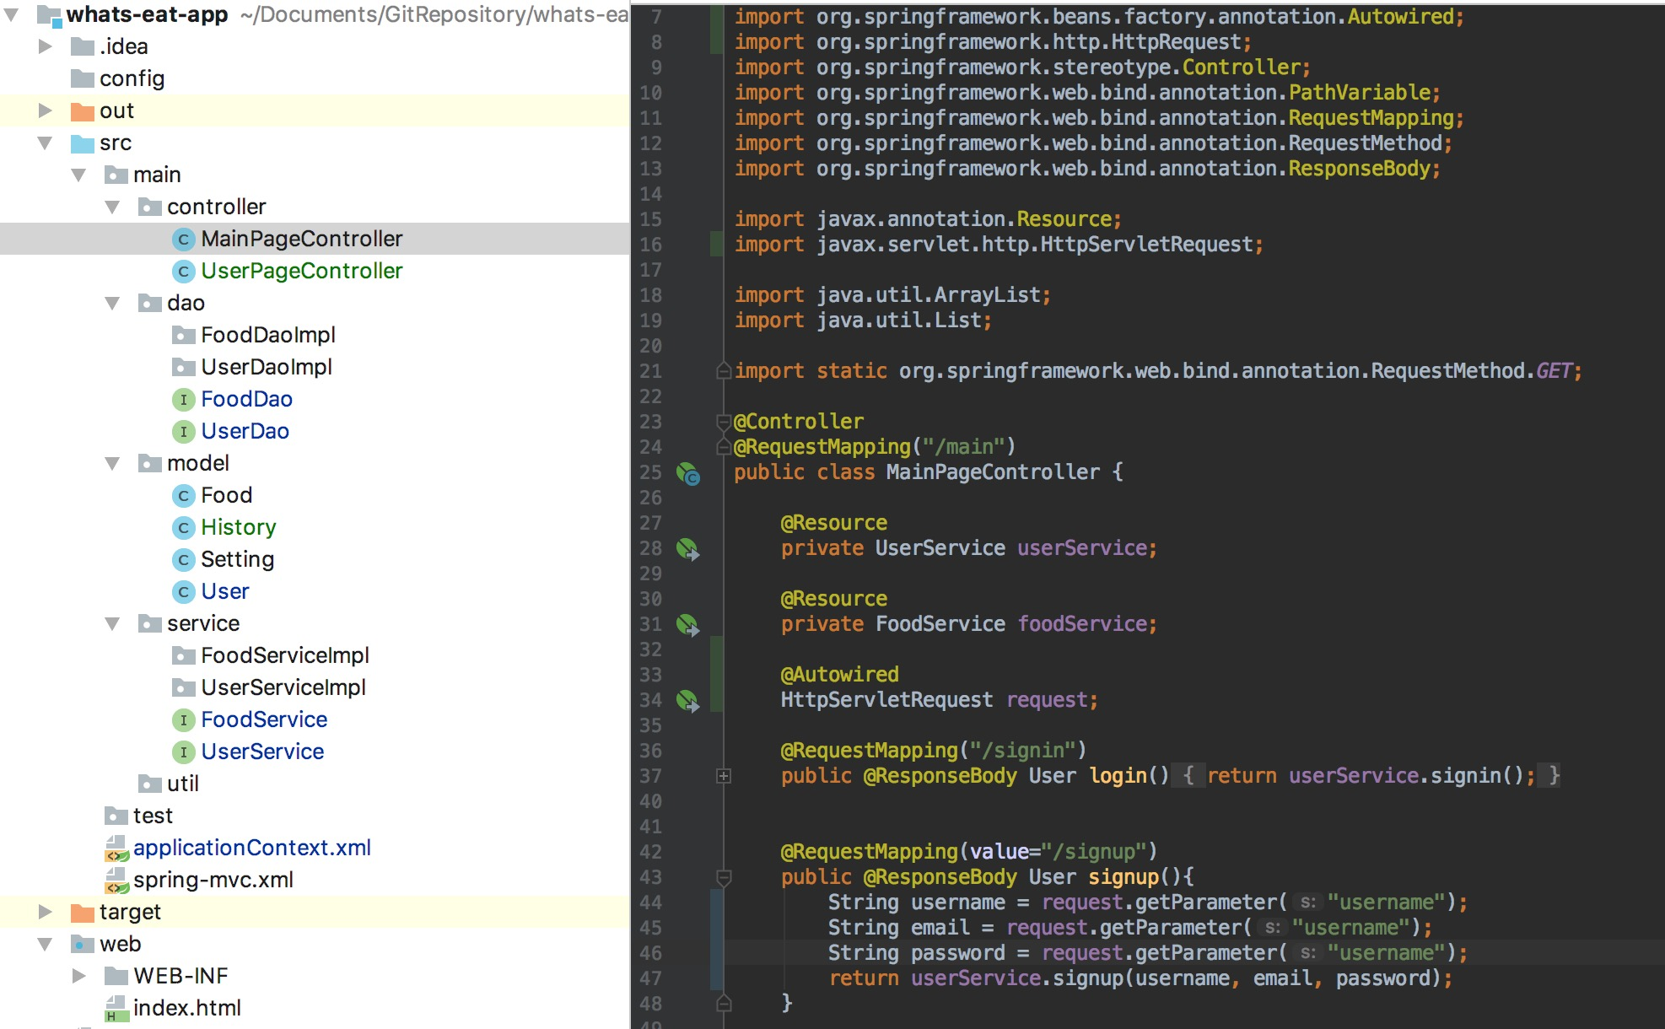
File structure
As you can see here, we have different folders for different layers, and for every interface we have a implementation folder. And by using SpringMVC, we can map every request path to a specific method, after finishing handling the request information, we can handle that to next layer.

Slide 5
Now let’s see a demo of our App!

